Slide 1
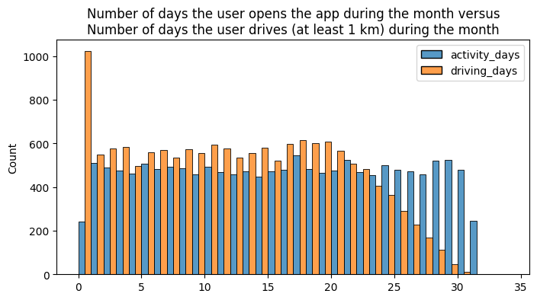
Predicts user churn project . Exploratory Data Analysis.
Executive summary report
Waze data Team was asked to analyze and interpret data, generate valuable insights, and help leadership make informed business decisions. The project is dedicated to help prevent user churn on the Waze app. Churn quantifies the number of users who have uninstalled the Waze app or stopped using the app. At this stage of the project data Team perform Exploratory Data Analysis and provide detailed inside about findings
The number of drives and the number of sessions are both strongly correlated, so they might provide redundant information when we incorporate both in a model.
The churn rate tends to increase as the mean daily distance driven increases.
The churn rate is highest for people who didn't use Waze much during the last month. The more times they used the app, the less likely they were to churn.
Large proportion of a user's total drives might have taken place in the last month, yet the overall median time since onboarding is almost five years.
Half of the users drove less than \~1,478 minutes (\~25 hours), but some users clocked over 250 hours over the month.
The proportion of churned users to retained users is consistent between iPhone and Android users.
The maximum km per day on trip is 15,420 kilometers which is impossible, average no more than 1200 km
The number of days users drove each month is almost uniform, and it largely correlates with the number of days they opened the app that month
~500 users opening the app on each of most of the day counts, but there were only ~250 users who did not open the app at all during the month and ~250 users who opened the app every day. This issue needs to be investigated further
Dealing with missing data (700 rows without label)
There are many outlying observations for drives, so we might consider a variable transformation to stabilize the variation.
investigating further the reasons for long-distance users to discontinue using the app.

